Slide 1
SPAM EMAIL DETECTION
Innovative ninjas

Slide 2
TEAM MEMBERS:
► S.M.SUVETHI
► V.SHARMILA
►S.SAKTHIPRIYA
►S.SHARANI
► S.GEO LIVINGSTION
► S.SYED JAVVATH AHAMED

Slide 3
INTRODUCTION: Spam email detection is a critical component of modern communication systems, aimed at identifying and filtering unsolicited or harmful messages. As spam tactics become more advanced, effective detection relies on machine learning and natural language processing techniques to ensure email security, reduce clutter, and protect user from phishing and malware threats.

Slide 4
ACHIEVEMENT OF THIS PROJECT:
This project successfully developed an automated spam email detection system with high accuracy, leveraging machine learning techniques to classify emails as spam or legitimate. It demonstrated improved filtering performance, reduced false positives, and enhanced overall email security, making it a reliable solution for real-world applications.

Slide 5
IMPORTANCE OF SPAM DETECTION:
∙Enhances Security: Prevents phishing attacks, malware, and data breaches.
∙ Reduces Inbox Clutter: Filters out irrelevant and unwanted messages.
∙ Saves Time: Helps users focus on important emails by minimizing distractions.
∙ Protects Sensitive Information: Blocks emails that attempt to steal personal or financial data.
∙Improves System Performance: Reduces server load by minimizing the processing of spam.
∙Boosts Productivity: Allows users to manage emails more efficiently.
∙Supports Compliance: Helps organizations comply with data protection and email usage policies.

Slide 6
ROLE OF PROJECT:
✦ Identifies Unwanted Emails: Automatically detects and filters spam messages from legitimate emails.
✦ Improves Email Security: Protects users from phishing, scams, and malware
✦ Reduces Manual Effort: Minimizes the need for users to sort and delete spam emails manually.
✦ EnhancesUser Experience: Ensures a cleaner and more organized inbox.
✦ Learns and Adapts: Uses machine learning to improve accuracy over time.
✦ Supports IT Infrastructure: Reduces server load and bandwidth usage caused by spam traffic.
✦ Contributes to Data Privacy: Helps prevent unauthorized access to sensitive user information.

Slide 7

Technologies used:
✸ Machine Learning Algorithms (e.g., Naive Bayes, SVM, Random Forest)
✸ Natural Language Processing (NLP) for analyzing email content
✸ Text Preprocessing (tokenization, stemming, stop-word removal)
✸ Feature Extraction Techniques (e.g., TF-IDF, Bag of Words)
✸ Python Libraries (e.g., Scikit-learn, NLTK, Pandas) for implementation
✸ Dataset Management (e.g., using public datasets like SpamAssassin or Enron)
✸ Model Evaluation Metrics (e.g., Accuracy, Precision, Recall, F1-score)

Slide 8
WHAT IS NLP? Natural Language Processing (NLP) plays a key role in spam email detection by analyzing the text content of emails. It helps in: ➔ Extracting and cleaning text (e.g., removing stop words, punctuation, etc.) ➔ Tokenization – splitting email text into words or phrases ➔ Stemming and Lemmatization – reducing words to their root forms ➔ Identifying spam keywords or patterns ➔ Converting text into numerical features using techniques like TF-IDF or Bag of Words ➔ Understanding context and sentiment in advanced models

Slide 9
Removing unwanted characters, HTML tags, and special symbols. ◘ Tokenization: Splitting email text into individual words or tokens. ◘ Stop Words Removal: Eliminating common words like “the,” “is,” and “and” that don’t help in classification. ◘ Stemming/Lemmatization: Reducing words to their root forms (e.g., “running” to “run”). ◘ Feature Extraction: Converting text into numerical features using methods like Bag of Words or TF-IDF. ◘ Labeling: Ensuring each email is marked as spam or non-spam for supervised learning.
DATA PROCESSING:

Slide 10
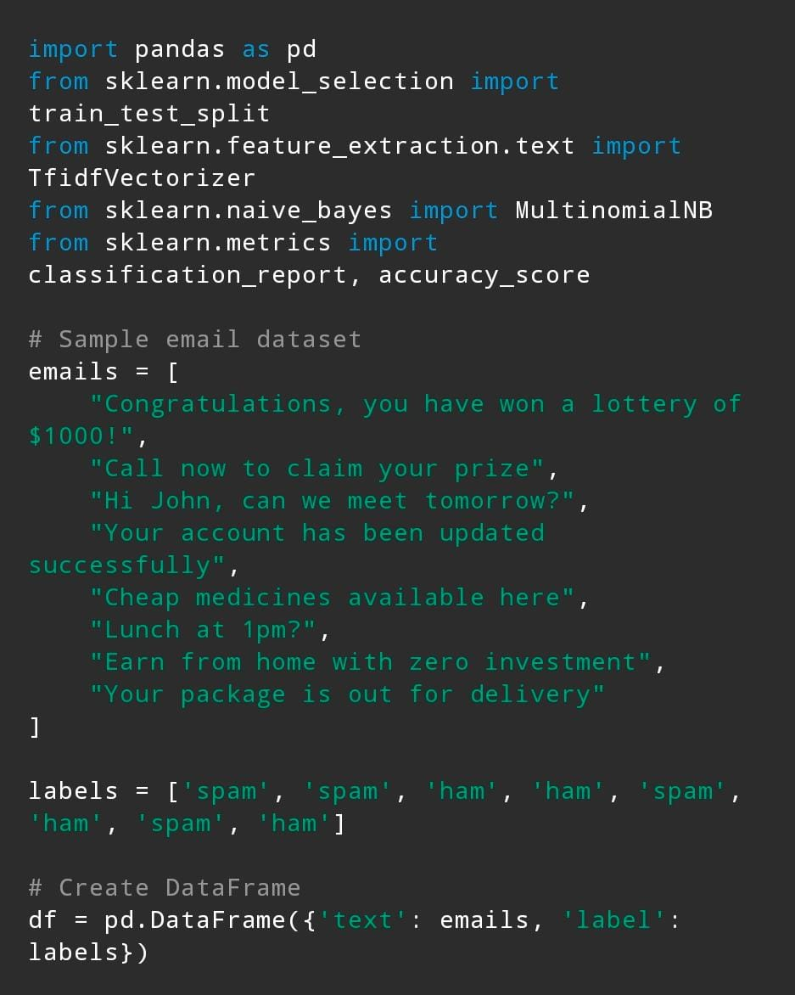
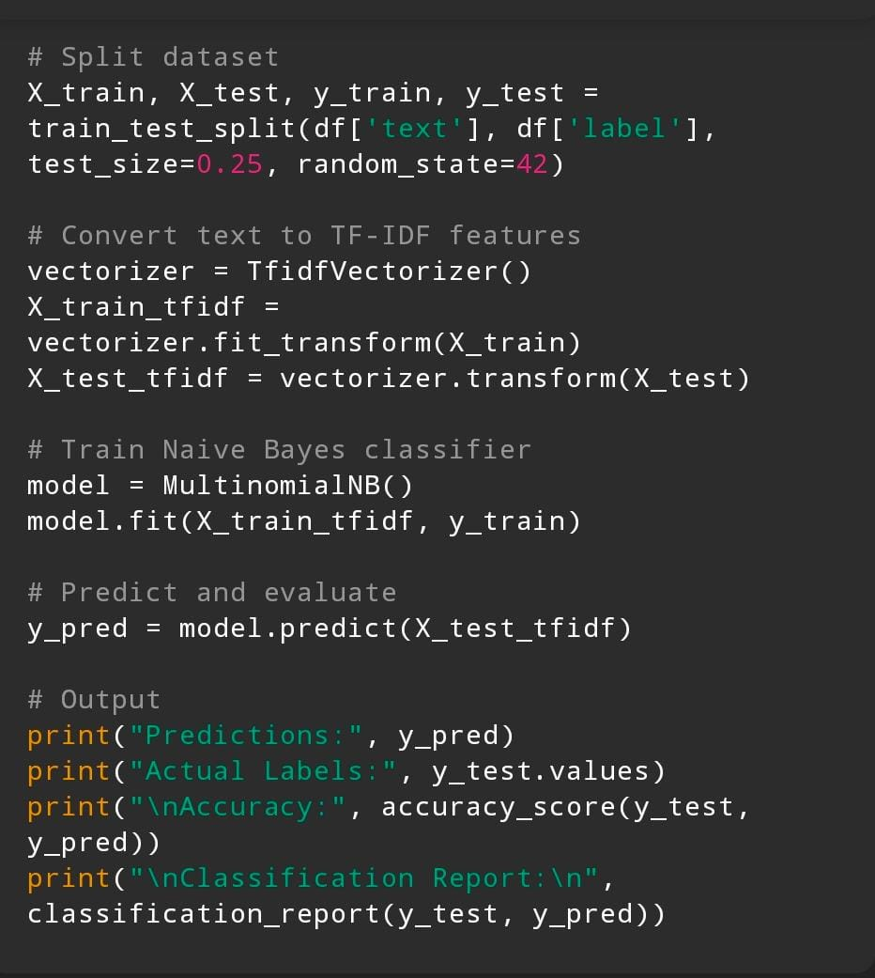
SAMPLE INPUT:

Slide 11
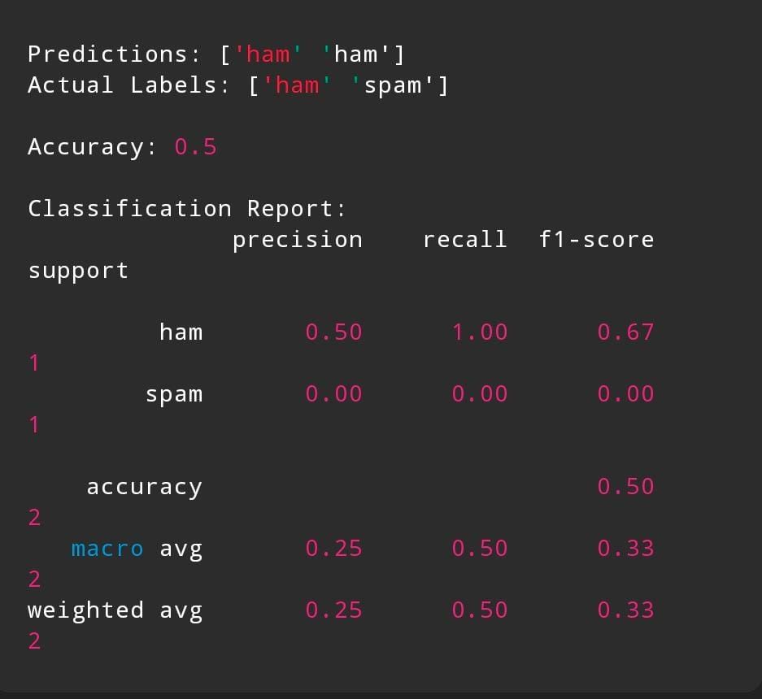
SAMPLE OUTPUT:

Slide 12
CHALLENGES FACED:
✺ False Positives: Legitimate emails may be incorrectly marked as spam, causing important messages to be missed.
✺ False Negatives: Some spam emails evade detection and reach the inbox.
✺ Imbalanced Data: Spam datasets often have more legitimate emails than spam, making training difficult.
✺ Language and Format Variations: Spam emails can use different languages, slang, or obfuscation techniques.
✺ High Volume of Emails: Processing large volumes of emails efficiently is challenging.
✺ Encrypted or Image-based Spam: Spam hidden inside images or encrypted content is harder to detect.

Slide 13
ADVANTAGES:
♦♦ Improves Security.
♦♦ Reduces Inbox Clutter.
♦♦ Saves Time.
♦♦ Productivity.
♦♦ Sensitive Information.
♦♦ Improves System Performance.
♦♦ Supports Compliance.

Slide 14
CONCLUSION:
Spam email detection is essential for maintaining secure and efficient communication in today’s digital world. By using advanced techniques such as machine learning and natural language processing, spam filters can accurately identify and block unwanted or harmful emails. This not only protects users from security threats but also improves inbox management and productivity. Continuous improvement and adaptation to evolving spam tactics remain crucial to ensuring the effectiveness of spam detection systems.

Slide 15
THANK YOU

